Slide 1
E-mail Security
  PGP, S/MIME
Certificates and PKI

Slide 2
E-mail Security
E-mail is one of the most widely used network services
  One of the old killer applications of the Internet
Normally message contents not secured
  Can be read/modified either in transit or at destination by the attacker
E-mail service is like postcard service
  just pick it and read it

Slide 3
Email Security Enhancements
confidentiality
  protection from disclosure
authentication
  of sender of message
message integrity
  protection from modification
non-repudiation of origin
  protection from denial by sender

Slide 4
Pretty Good Privacy (PGP)
widely used secure e-mail software
  originally a file encryption/decryption facility
developed by Phil Zimmermann
  a security activist who has had legal problems due to PGP
best available crypto algorithms are employed
available on several platforms with source code
originally free, now commercial versions exist
not controlled by a standardization body
  although there are RFCs

Slide 5
PGP Mechanisms
Digital Signatures (and consequently message authentication and integrity)
  RSA, DSS
Message Encryption
  CAST, IDEA, 3DES, AES (all at least 128 bits)
  symmetric keys are used once and encrypted using RSA or ElGamal (based on discrete logs)
Compression using ZIP
Radix-64 conversion (to ASCII)
  for e-mail compatibility

Slide 6
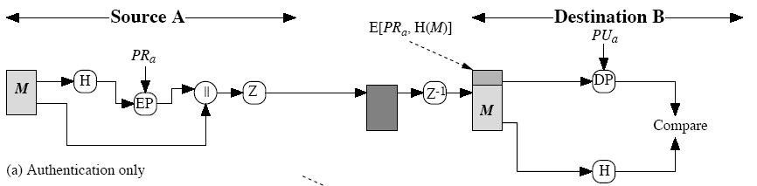
PGP Operation – Digital Signatures
Classical application of public key crypto
  This figure is actually for RSA
  for DSA refer to previous lectures
Z is zip function
radix-64 conversion is done after zip at sender, before Z⁻¹ at receiver
  may be done only for signature or for the whole message

Slide 7
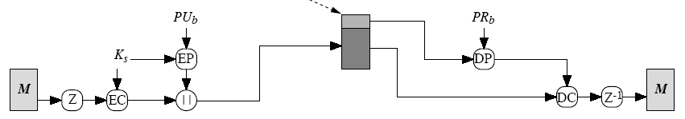
PGP Operation – Confidentiality
E[PU_{b}, K_{s}]
One-time session key, K_{s}
  generated at random
  encrypted using a public key cryptosystem, EP
    RSA or ElGamal
Message is compressed before encryption
  This is the default case

Slide 8
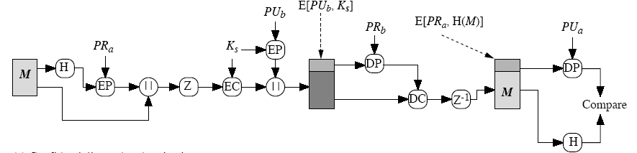
PGP Operation – Confidentiality and Authentication
uses both services on same message
  create signature and attach to message
  compress and encrypt both message & signature
  attach encrypted session key
  radix-64 conversion is for everything at the end

Slide 9
S/MIME
Secure/Multipurpose Internet Mail Extensions
A standard way for email encryption and signing
IETF effort (RFCs 2632, 2633 – for version 3.0; RFCs 3850, 3851 for version 3.1; 5750, 5751 for version 3.2)
Industry support
Not a standalone software, a system that is to be supported by email clients
  such as MS Outlook and Thunderbird
S/MIME handles digital signatures
  Also provides encryption

Slide 10
Quick E-mail History
SMTP and RFC 822 (later RFC 5322)
  SMTP is the email transfer protocol running over TCP
  RFC 822/5322 defines the message format and headers
    only ASCII messages (7-bit)
MIME (Multipurpose Internet Mail Extensions)
  content type
    Almost any type of information can appear in an email message
  transfer encoding
    specifies how the message body is encoded into textual form (radix64 is common)
S/MIME: Secure MIME
  new content types, like signature, encrypted data

Slide 11
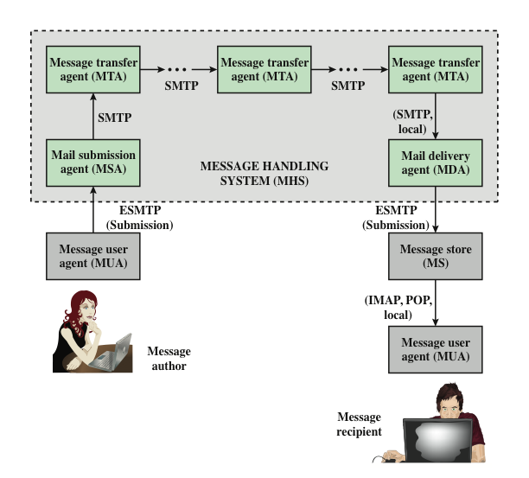
More on Internet Email Architecture
Notes:
At its most fundamental level, the Internet mail architecture consists of a
user world in the form of Message User Agents (MUA), and the transfer world, in
the form of the Message Handling Service (MHS), which is composed of Message
Transfer Agents (MTA). The MHS accepts a message from one user and delivers
it to one or more other users, creating a virtual MUA-to-MUA exchange environment.
This architecture involves three types of interoperability. One is directly between
users: messages must be formatted by the MUA on behalf of the message
author so that the message can be displayed to the message recipient by the destination
MUA. There are also interoperability requirements between the MUA and the
MHS—first when a message is posted from an MUA to the MHS and later when
it is delivered from the MHS to the destination MUA. Interoperability is required
among the MTA components along the transfer path through the MHS.
Figure 19.1 illustrates the key components of the Internet mail architecture,
which include the following.
• Message User Agent (MUA): Operates on behalf of user actors and user applications.
It is their representative within the e-mail service. Typically, this
function is housed in the user’s computer and is referred to as a client e-mail
program or a local network e-mail server. The author MUA formats a message
and performs initial submission into the MHS via a MSA. The recipient
MUA processes received mail for storage and/or display to the recipient user.
• Mail Submission Agent (MSA): Accepts the message submitted by an MUA
and enforces the policies of the hosting domain and the requirements of
Internet standards. This function may be located together with the MUA or
as a separate functional model. In the latter case, the Simple Mail Transfer
Protocol (SMTP) is used between the MUA and the MSA.
• Message Transfer Agent (MTA): Relays mail for one application-level hop.
It is like a packet switch or IP router in that its job is to make routing assessments
and to move the message closer to the recipients. Relaying is performed
by a sequence of MTAs until the message reaches a destination MDA. An
MTA also adds trace information to the message header. SMTP is used between
MTAs and between an MTA and an MSA or MDA.
• Mail Delivery Agent (MDA): Responsible for transferring the message from
the MHS to the MS.
• Message Store (MS): An MUA can employ a long-term MS. An MS can be
located on a remote server or on the same machine as the MUA. Typically,
an MUA retrieves messages from a remote server using POP (Post Office
Protocol) or IMAP (Internet Message Access Protocol).
Two other concepts need to be defined. An administrative management
domain (ADMD) is an Internet e-mail provider. Examples include a department
that operates a local mail relay (MTA), an IT department that operates an enterprise
mail relay, and an ISP that operates a public shared e-mail service. Each
ADMD can have different operating policies and trust-based decision making. One
obvious example is the distinction between mail that is exchanged within an organization
and mail that is exchanged between independent organizations. The rules for
handling the two types of traffic tend to be quite different.
The Domain Name System (DNS) is a directory lookup service that provides
a mapping between the name of a host on the Internet and its numerical address.

Slide 12
More on MIME
Multipurpose Internet Mail Extensions
  Addresses the limitations of SMTP/5322 scheme
    Most important one: binary data transfer
    Attachments
Adds some fields to the email messages: Important ones:
  Content-Type
    Describes the data contained in the body with sufficient detail that the receiving user agent can pick an appropriate agent or mechanism to represent the data to the user
  Content-Transfer-Encoding
    Indicates the type of transformation that has been used to represent the body of the message in a way that is acceptable for mail transport

Slide 13
S/MIME Functions
enveloped data
  encrypted content and associated keys
signed data
  encoded message + encoded signed message digest
clear-signed data
  cleartext message + encoded signed message digest
signed and enveloped data
  Nested signed and encrypted entities

Slide 14
S/MIME Cryptographic Algorithms
hash functions: switched to SHA256
digital signatures: Mostly RSA is used
session key encryption: Mostly RSA is used
message encryption: Triple-DES, AES and others, but AES-128 is preferred
Base64 (radix64) encoding is used for email compatibility (ASCII conversion)
sender should know the capabilities of the receiving entity (public announcement or previously received messages from receiver)
  otherwise sender takes a risk of sending unintelligible e-mail.

Slide 15
S/MIME Certificate Processing
S/MIME uses X.509 v3 certificates
  Certification Authorities (CAs) issue certificates
  unlike PGP, a user cannot be a CA
each client has a list of trusted CA certificates
  actually that list comes with e-mail client software or OS
and own public/private key pairs and certs
It is very hard for an average user to maintain the list of trusted CAs
  Generally OS and/or email client software default trusted CA certificate lists are directly used.
  So trust management is not user-centric in practice

Slide 16
S/MIME Certificate Processing and CAs
One should obtain a certificate from a CA in order to send signed messages
Certificates classes (common practice by most CAs)
  Class 1
  Class 2
  Class 3
CA certification policies (Certificate Practice Statement)
  ID-control practices
    Class 1: only email address check
    Class 2: class1 + against third party database / fax documents
    Class 3: class1 + apply in person and submit picture IDs and/or paper documents
Stronger identity validation
Easier to issue

Slide 17
X.509 Certificates and PKIs
SSL and S/MIME uses X.509 certificates
  now we will see the details of them
  later we will continue with PKIs (Public Key Infrastructures)

Slide 18
Certificates
Yet another public-key distribution method
  first (conceptually) offered by Kohnfelder (1978)
Binding between the public-key and its owner
Issued (digitally signed) by the Certificate Authority (CA)

Slide 19
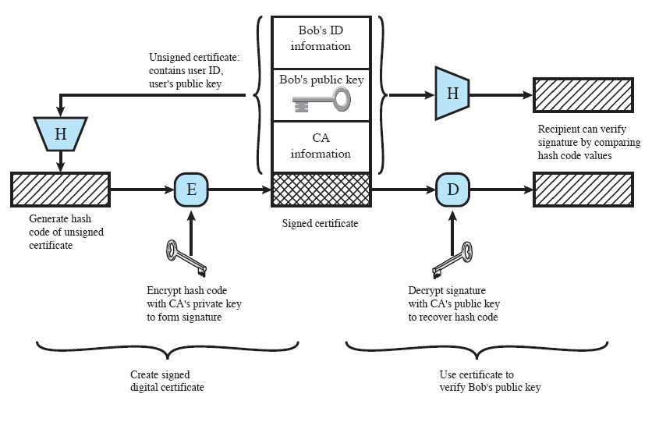
Certificates

Slide 20
Certificates
Certificates are verified by the verifiers to find out correct public key of the target entity
Certificate verification is the verification of the signature on certificate
In order to verify a certificate, the verifier
  must know the public key of the CA
  must trust the CA

Slide 21



Certificates
CA
Certified Entity
Albert
Levi
Albert Levi
Albert Levi
Verifier

Slide 22
Issues Related Certificates
CA certification policies (Certificate Practice Statement)
  how reliable is the CA?
  certification policies describe the methodology of certificate issuance
  ID-control practices
    loose control: only email address
    tight control: apply in person and submit picture IDs and/or hard documentation

Slide 23
Issues Related Certificates
TRUST
  verifiers must trust CAs
  CAs need not trust the certified entities
  certified entities need not trust its CA
What is “trust” in certification systems?
  Answer to the question: “How correct is the certificate information?”
  related to certification policies

Slide 24
Issues Related Certificates
Certificate types
  ID certificates
    discussed here
  authorization certificates
    no identity
    binding between public key and authorization info
Certificate storage and distribution
  along with a signed message
  distributed/centralized databases

Slide 25
Issues Related Certificates
Certificate Revocation
  certificates have lifetimes, but they may be revoked before the expiration time
  Reasons:
    certificate holder key compromise/lost
    CA key compromise
    end of contract (e.g. certificates for employees)
  Certificate Revocation Lists (CRLs) hold the list of certificates that are not expired but revoked
    each CA periodically issues such a list with digital signature on it

Slide 26
Real World Analogies
Is a certificate an “electronic identity”?
Concerns
  a certificate is a binding between an identity and a key, not a binding between an identity and a real person
  anyone can submit someone else’s certificate
  one must submit its certificate to identify itself, but submission is not sufficient, the key must be used in a protocol

Slide 27
Real World Analogies
Result: Certificates are not picture IDs
So, what is the real world analogy for certificates?
  Endorsed document/card that serves as a binding between the identity and signature

Slide 28
Public Key Infrastructure (PKI)
PKI is a complete system and well-defined mechanisms for certificates
  certificate issuance
  certificate revocation
  certificate storage
  certificate distribution

Slide 29
PKI
Business Practice: Issue certificates and make money
  several CAs
Several CAs are also necessary due to political, geographical and trust reasons
3 interconnection models
  hierarchical
  cross certificates
  hybrid

Slide 30
Hierarchical PKI Example
Root CA
Upper level CAs
CAs
End users

Slide 31
Cross Certificate Based PKI Example
CAs
End users
Cross certificates

Slide 32
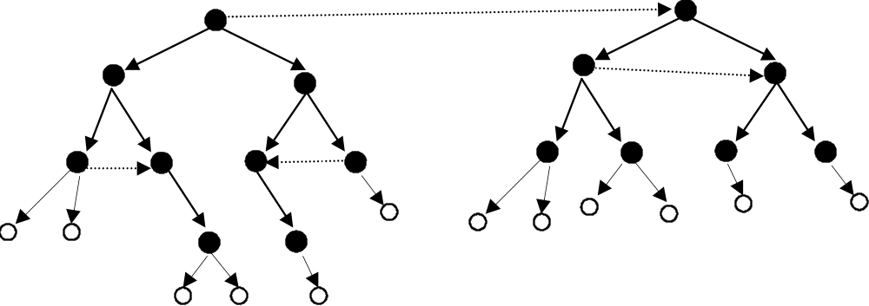
Hybrid PKI example

Slide 33
Certificate Paths

Slide 34

Certificate Paths
Verifier must know public key of the first CA
Other public keys are found out one by one
All CAs on the path must be trusted by the verifier

Slide 35
Certificate Paths with Reverse Certificates
Reverse certificates

Slide 36
Organization-wide PKI
Local PKI for organizations
  may have global connections, but the registration facilities remain local
  generally to solve local problems
    local secure access to resources

Slide 37
Organization-wide PKI
PKI Server
Certificate Processor/Authority
CP (CA)
Databases / Directories
Administration
Registration Authority
Certificate Distribution
RA
CD
PKI Client
Architecture of a typical organization
-
wide PKI

Slide 38
Hosted vs. Standalone PKI
Hosted (outsourced) PKI
  PKI vendor acts as CA
  PKI owner is the RA
Standalone PKI
  PKI owner is both RA and CA

Slide 39
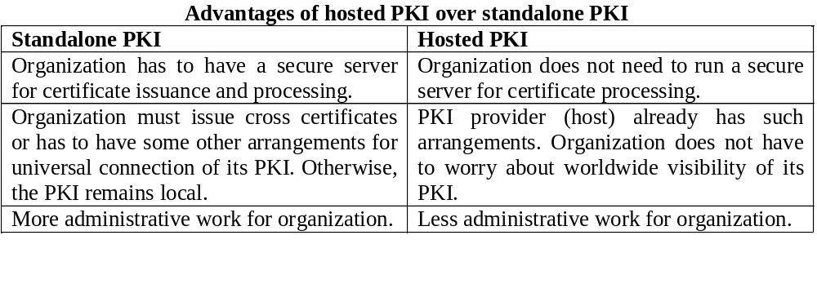
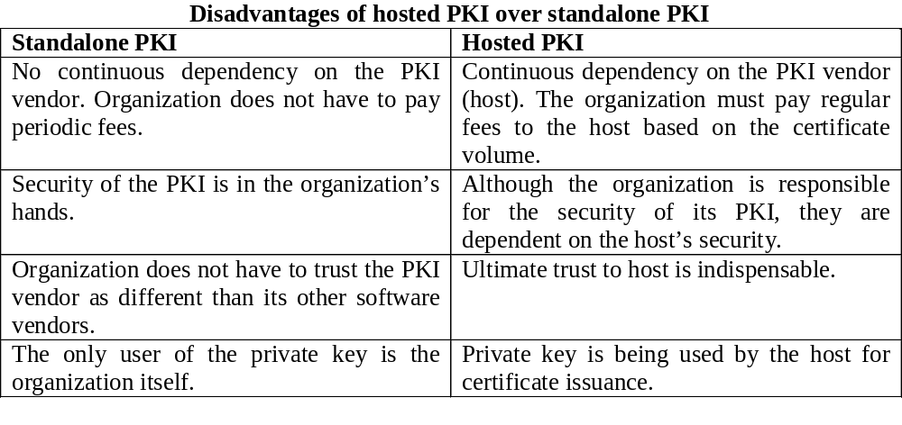
Hosted vs. Standalone PKI

Slide 40
X.509
ITU-T standard (recommendation)
  ISO 9495-2 is the equivalent ISO standard
part of X.500 family for “directory services”
  distributed set of servers that store user information
    an utopia that has never been carried out
  X.509 defines the authentication services and the pubic-key certificate structure (certificates are to be stored in the directory)
  so that the directory would contain public keys of the users

Slide 41
X.509
Defines identity certificates
  attribute (authorization) certificates are added in 4th edition (2000)
Defines certificate structure, not PKI
Supports both hierarchical model and cross certificates
End users cannot be CAs

Slide 42
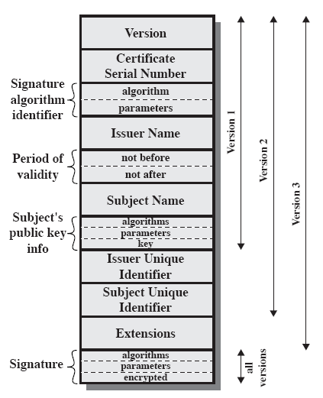
X.509 Certificate Format

Slide 43
X.509v3 Extensions
Not enough flexibility in X.509 v1 and v2
  mostly due to “directory” specific fields
  real-world security needs are different
    email/URL names should be included in a certificate
    key identification was missing (so should be included)
    policy details should indicate under which conditions a certificate can be used (was not the case in v1 and v2)
    avoidance of blind trust was not possible in v1 and v2
Rather than explicitly naming new fields a general extension method is defined
  An extension consists of an extension identifier, value and criticality indicator

Slide 44
X.509v3 Extensions
Key and policy information
  subject & issuer key identifiers
  indicators of certificate policies supported by the cert
  key usage (list of purposes like signature, encryption, etc)
Alternative names, in alternative formats for certificate subject and issuer
Certificate path constraints
  For CA certs and to restrict certificate issuance based on
    path length (restricting number of subordinate CAs)
    policy identifiers
    names
Verifier could exercise its own restrictions during verification as well
  No blind trust to CAs

